Slide 1
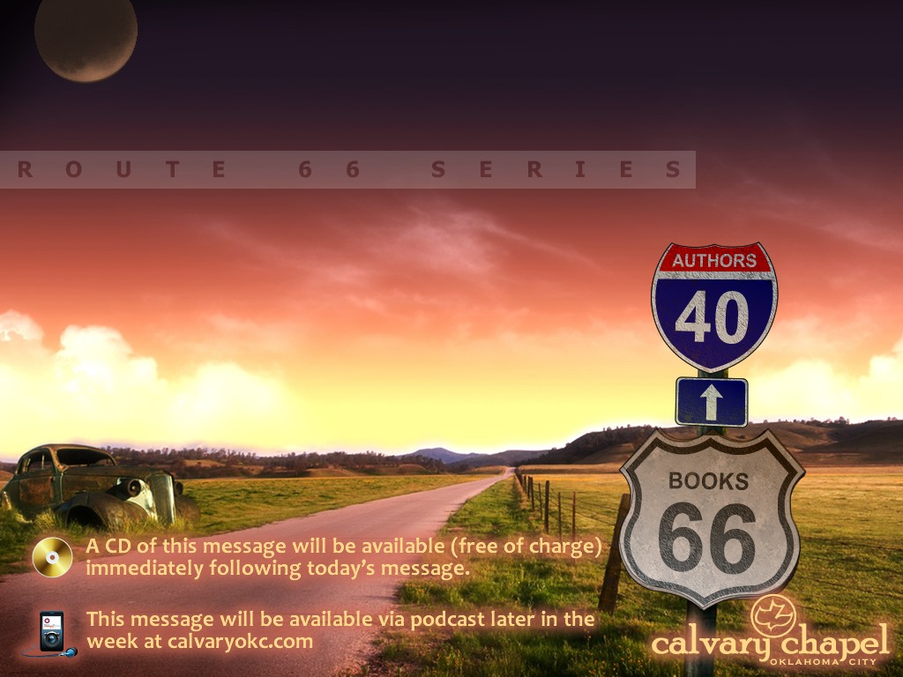
ISAIAH

Slide 2
ISAIAH
¹ “Ho! Everyone who thirsts,
Come to the waters;
And you who have no money,
Come, buy and eat.
Yes, come, buy wine and milk
Without money and without price.
² Why do you spend money for what is not bread,
And your wages for what does not satisfy?
Listen carefully to Me, and eat what is good,
And let your soul delight itself in abundance.
Isaiah 55.1-2

Slide 3
ISAIAH
Deutero-Isaiah theory:
Chapters 1-39
Chapters 40-66
Trito-Isaiah theory:
Chapters 1-39
Chapters 40-55
Chapters 56-66

Slide 4
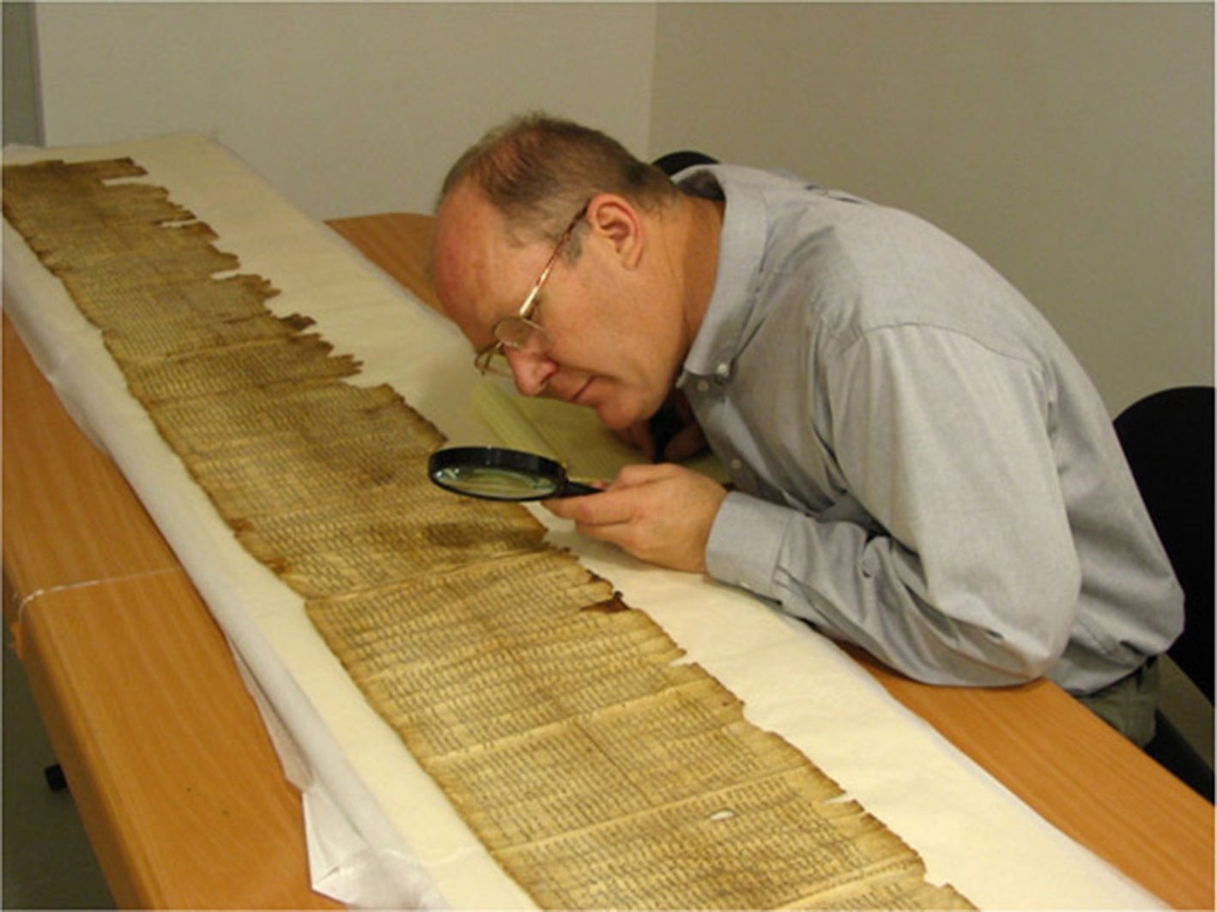
ISAIAH
External evidence:
Dead Sea Scrolls
Septuagint
Unbroken Jewish and Christian tradition
Gospel of John
Quoted directly over 65x
By name 22x in New Testament
The “Great Isaiah” Scroll

Slide 5
ISAIAH
Internal evidence:
Similar terms (Holy One of Israel – 25x)
Similar themes (highway; remnant)
Poetry and style

Slide 6
ISAIAH
Two separate themes:
Law and Judgment ~ 1-39
Salvation and Restoration ~ 40-66

Slide 7
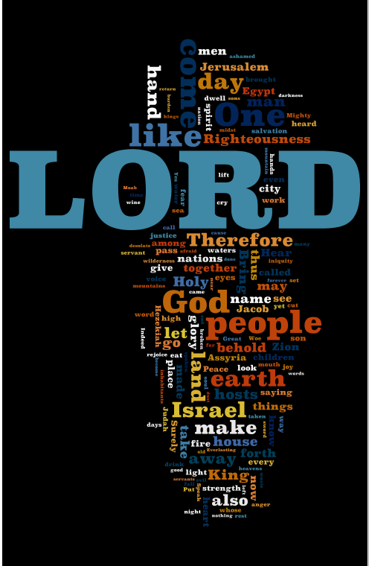
ISAIAH
Isaiah “Wordle”

Slide 8
ISAIAH
Isaiah ~ Yahweh is Salvation
Shear-Jashub (the remnant shall return, 7:3)
Maher-shalal-hash-baz (hasting to the spoil, 8:3)

Slide 9
ISAIAH
800 BC
760 BC
730 BC
700 BC
Jotham
750-732 BC
Hezekiah
725-687 BC
Uzziah
792-740 BC
Ahaz
735-715 BC
Isaiah Timeline

Slide 10
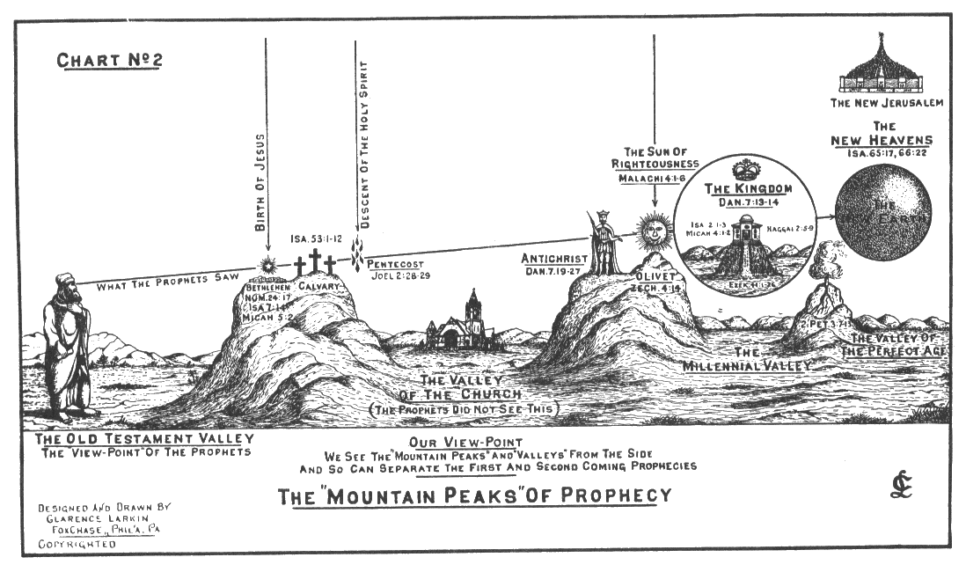
ISAIAH
The Prophets’ Perspective

Slide 11
ISAIAH
"Stoop down low and go in at the first 'all' and stand straight and come out at the last 'all'"

